Slide 1
Anti-Aging Scheduling in Single-Server Queues: A Systematic and Comparative Study
IEEE INFOCOM 2020 AoI Workshop
Virtual Conference
Zhongdong Liu
Center for Networked Computing (CNC)
Department of Computer & Information Sciences
Temple University
Joint work with
Liang Huang (Zhejiang University of Technology), Bin Li (University of Rhode Island) and Bo Ji (Temple University)

Slide 2
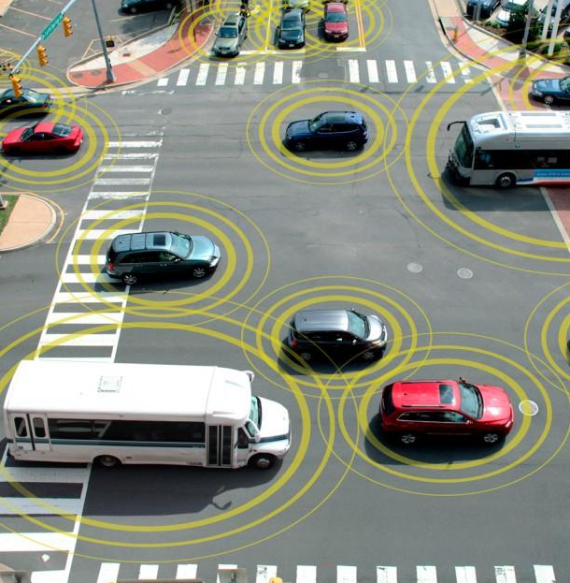
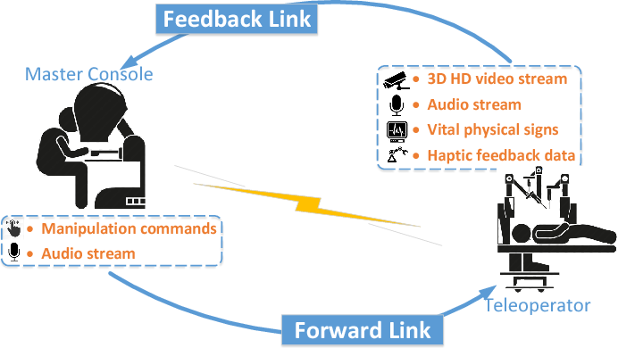
Freshness Matters
Real-time services are ubiquitous
Intelligent transportation systems & vehicular networks
Sensor networks (for environment/health monitoring), wireless channel feedback, news feeds, weather updates, fare aggregating, etc.
A
B
(a) Intelligent vehicular networks
(b) Sensor networks

Slide 3









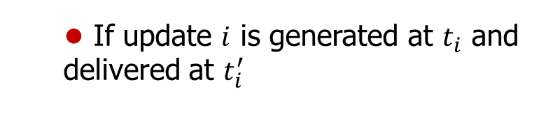
Age of Information: Definition
A simple abstract model
Source/Server/Receiver (Monitor)
Performance of interest:
freshness of update at the monitor
Source
Server
Receiver
(Monitor)
the time elapsed since generation
Definition
At time $t$, the Age-of-information (AoI) $∆\left(t\right)$ is the “age” of the “youngest” update that was delivered to the receiver before time $t$
the latest
If update $i$ is generated at $t_{i}$ and delivered at $t_{i}^{′}$
AoI: defined for a sequence of updates
$$∆\left(t\right)=t−max\left\{t_{i}:t_{i}^{′}≤t\right\}$$
Delay of update i
Delay of update i+1
Delay: defined for individual update
AoI grows linearly and drops upon new update delivered
$$45°$$
$$t_{i}$$
$$t_{i}^{′}$$
$$t_{i+1}$$
$$t_{i+1}^{′}$$

Slide 4
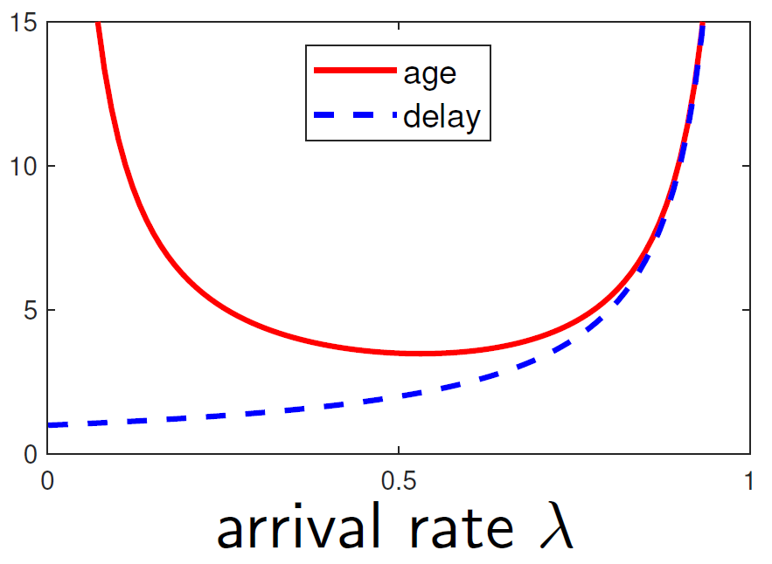
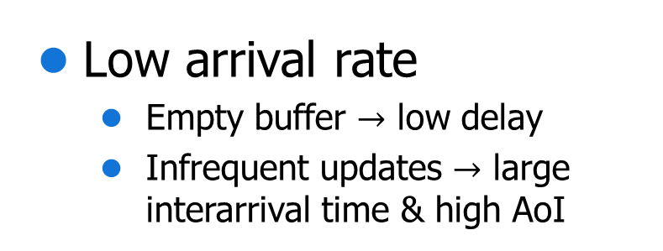
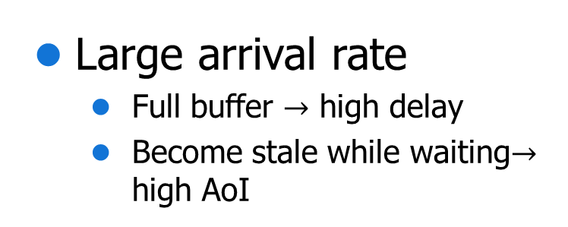
AoI vs. Delay
AoI depends on both
Queueing delay (how fast to deliver)
Inter-arrival time (how often to generate)
Low arrival rate
Empty buffer $→$ low delay
Infrequent updates $→$ large interarrival time & high AoI
Large arrival rate
Full buffer $→$ high delay
Become stale while waiting$→$ high AoI
In M/M/1 FCFS queues: [Kaul et al.,12]
AoI first decreases, then increases with arrival rate
Delay increases with arrival rate

Slide 5
Anti-Aging Scheduling
Motivation & Position
Preemptive, informative
(Literature)
Preemptive, informative, AoI-based
Arrival-time-based
(Literature)
Size-based
AoI-based
Contributions
Investigate the impact of scheduling policies on the AoI performance
Summarize useful guidelines for the design of AoI-efficient policies
Equivalence between some size-based and AoI-based policies

Slide 6
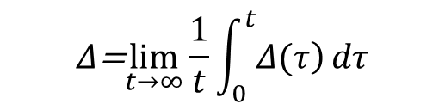
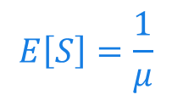



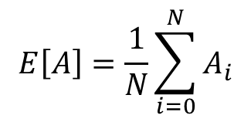







Anti-Aging Scheduling
System model: G/G/1
scheduling policies
Source
Server
Receiver
(avg. arrival rate: $λ$)
(avg. service rate: $μ$)
$S$:job size=service requirement
$$E\left[S\right]=\frac{1}{μ}$$
$$A_{i+1}$$
Performance metrics
Time Average AoI:
Average Peak AoI (PAoI):
$$A_{i}$$
$$Δ\text{=}\lim_{t→∞}\frac{1}{t}\int_{0}^{t}{\left.Δ(τ\right)}dτ$$
$$E\left[A\right]=\frac{1}{N}\sum_{i=0}^{N}{A_{i}}$$
$$t_{i+1}$$
$$t_{i+1}^{′}$$
$$t$$
$$t_{i}$$
$$t_{i}^{′}$$

Slide 7
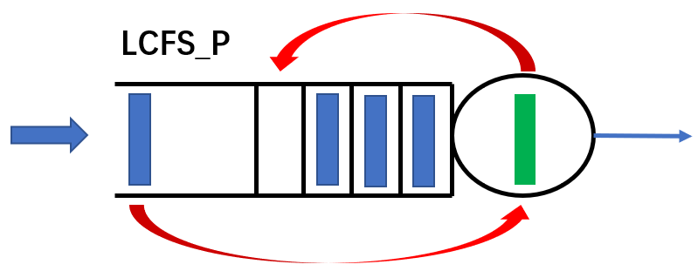
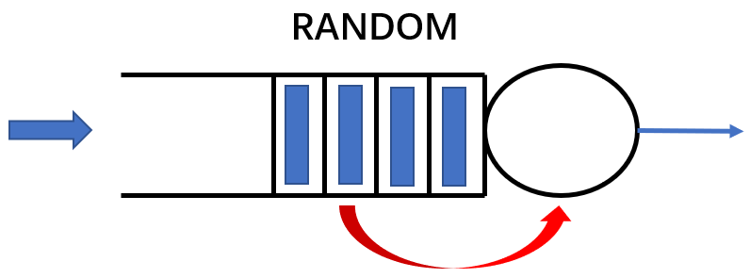
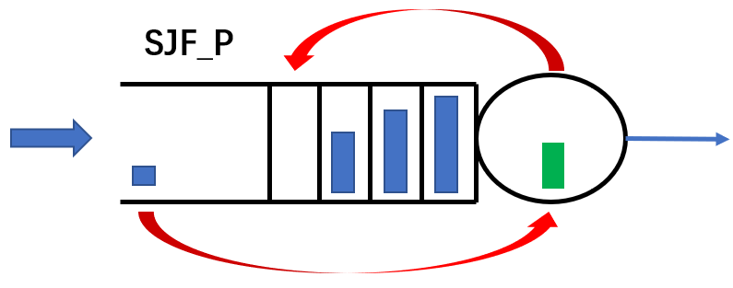
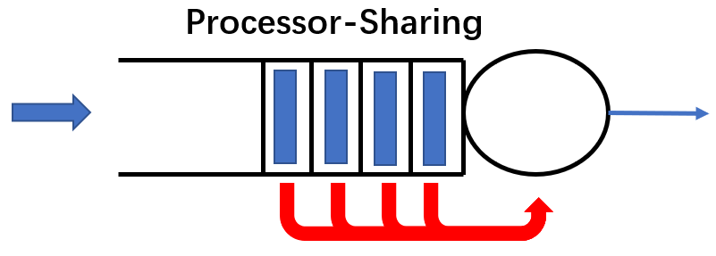
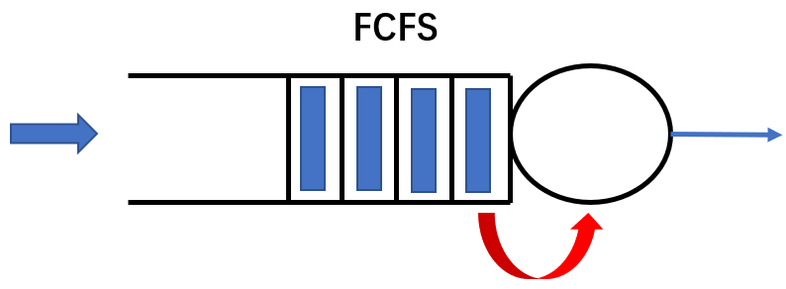
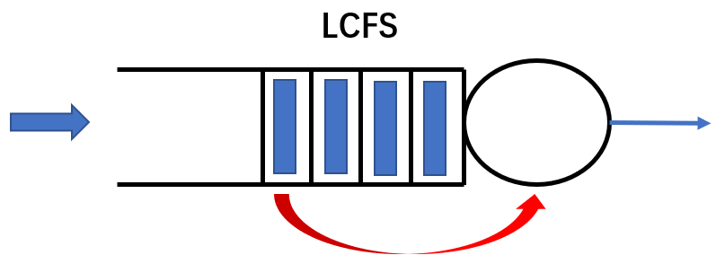
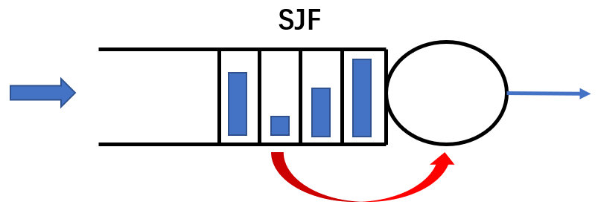
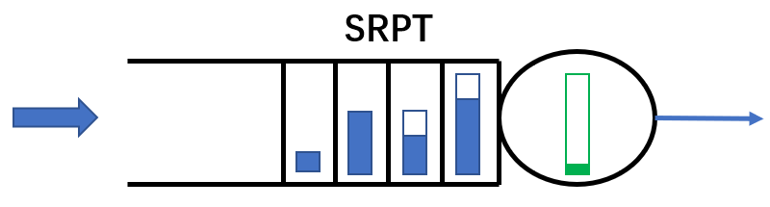
Sized-based Policies
Common scheduling policies
 | Non-preemptive | Preemptive
Blind to Size | FCFS (First-Come-First-Served) LCFS (Last-Come-First-Served) RANDOM (Random-Order-Service) | PS (Processor-Sharing) LCFS_P
Uses Size | SJF (Shortest-Job-First) | SJF_P SRPT (Shortest-Remaining-Processing-Time)
new old

Slide 8
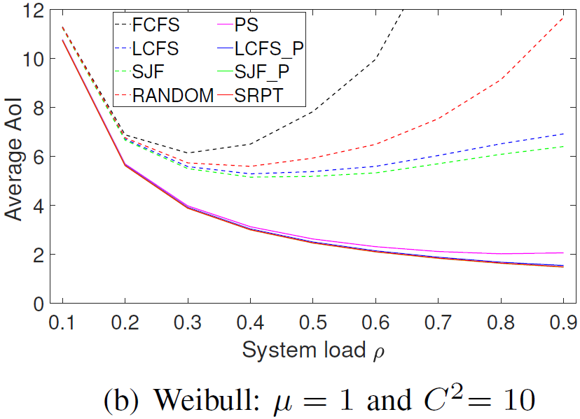
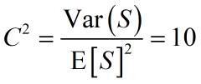
Sized-based Policies
Average AoI performance (with update size info.)
non-preemptive
size-based
preemptive
Observation 1: Size-based policies > Non-size-based policies
Guideline 1: Prioritizing updates with small size

Slide 9
Arrival-time-based Policies
Average AoI performance (without update size info.)
non-preemptive
prioritizing
recent update
preemptive
Guideline 2: Prioritizing recent updates
[Kaul et al., 2012; Costa et al., 2016]
Observation 2: LCFS>FCFS, RANDOM; LCFS_P>PS

Slide 10
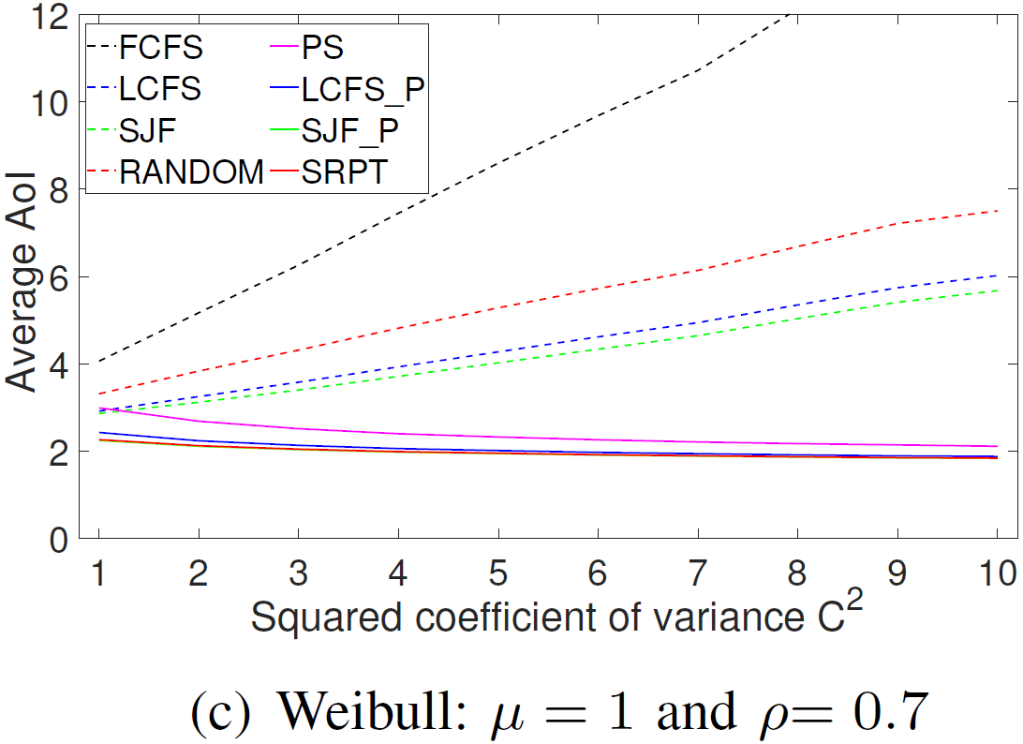
Preemptive Policies
Average AoI performance (with service preemption)
non-preemptive
non-preemptive
preemptive
preemptive
Observation 3:
Preemptive>Non-preemption
Observation 4:
Preemptive policies are less sensitive to update size variability
Guideline 3: Allowing service preemption
[Kaul et al., 2012; Bedeway et al., 2016; Najm et al,. 2018]

Slide 11
Current Guidelines
Summary of guidelines
 | Non-preemptive | Preemptive
Blind to Size | FCFS (First-Come-First-Served) LCFS (First-Come-First-Served) RANDOM (Random-Order-Service) | PS (Processor-Sharing) LCFS_P
Uses Size | SJF (Shortest-Job-First) | SJF_P SRPT (Shortest-Remaining-Processing-Time)
Guideline 1: Prioritizing updates with small size
AoI-based Policies
Guideline 2: Prioritizing recent updates
Guideline 3: Allowing service preemption

Slide 12
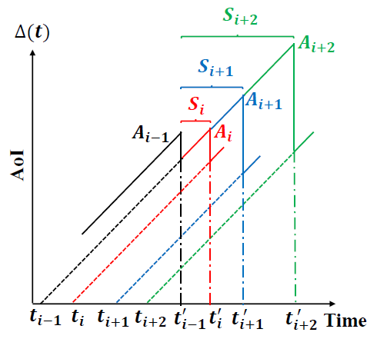
AoI-based Policies
AoI-based policies
AoI-Drop-Earliest (ADE): make next AoI drop the earliest
AoI-Drop-to-Smallest (ADS): making the next AoI drop to the smallest
AoI-Drop-Most (ADM): making the next AoI drop most

Slide 13
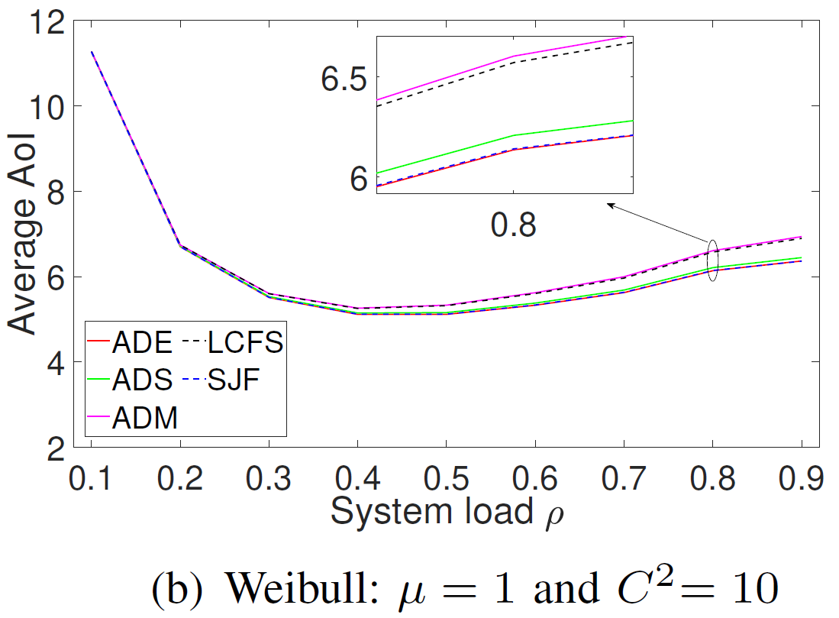
AoI-based Policies
AoI-based policies vs. non-AoI-based policies
Guideline 4: AoI-based policies can further improve the AoI performance

Slide 14
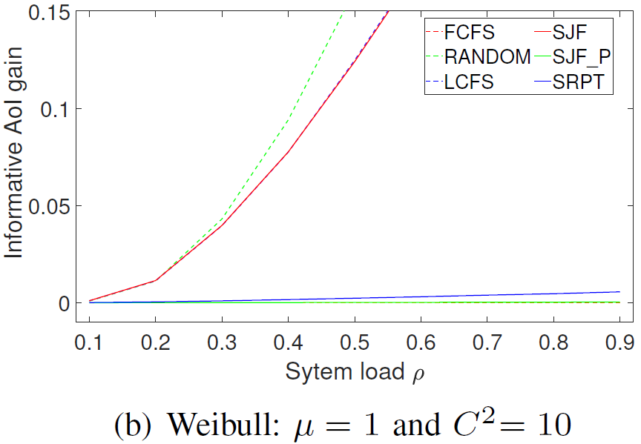
Informative Policies
Informative policies
Informative policies only serve informative updates (can make AoI drop)
Almost all introduced policies have “informative” version
Informative policies vs. Non-informative policies
Guideline 5: Prioritizing informative updates
[Costa et al., 2014; Pappas et al., 2015]
Theoretical result
Proposition 1: In the G/M/1 queueing system, the AoI under
LCFS_I is stochastically smaller than that under LCFS.

Slide 15
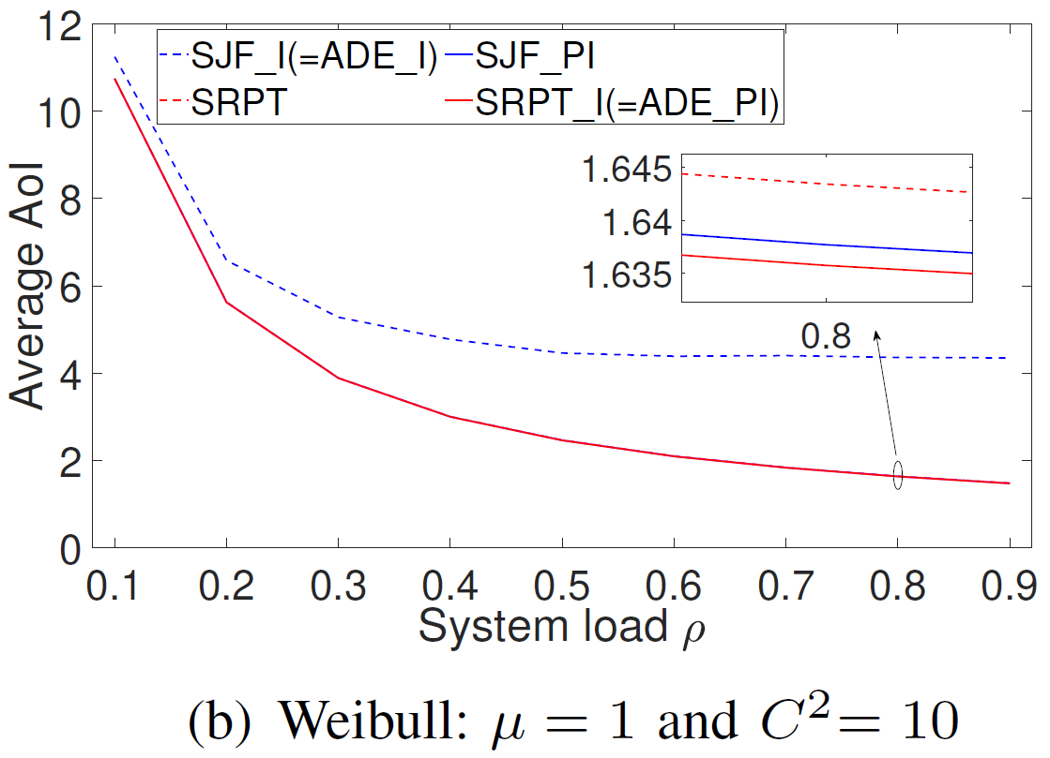
Preemptive, Informative, AoI-based Policies
Simulation results
Sample path equivalence results
Proposition 2: SRPT_I is equivalent to ADE_PI.
Proposition 3: SJF_I is equivalent to ADE _I.

Slide 16
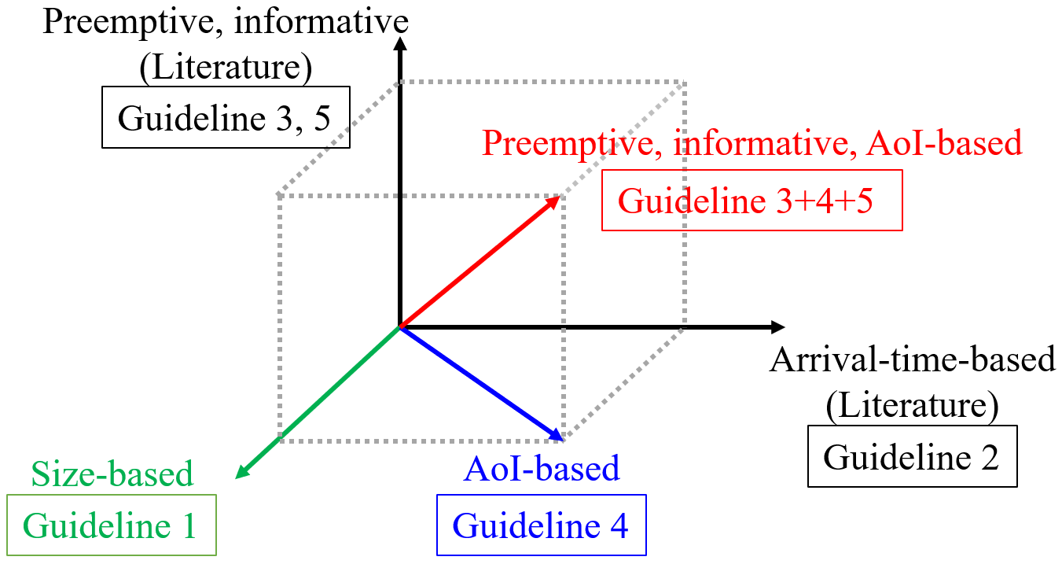
Conclusion
Design AoI-efficient scheduling policies
Prioritizing small updates, allowing service preemption, prioritizing informative updates
Equivalence between some size-based and AoI-based policies
SRPT_I = ADE_PI; SJF_I=ADE_I
Delay-efficient → AoI-efficient (for exogenous source)
High load: delay dominates Low load: interarrival dominates

Slide 17
Future Work
Pursue more theoretical results
Does any informative policy always outperform its non-informative counterpart?
Can we derive the closed-form formulas of the average AoI/PAoI for the AoI-efficient scheduling policies (such as SRPT)?
Apply to more complex network
Does our guidelines hold for multi-server queues?
What’s the performance of our policies/guidelines in a more complex network (e.g., multi-hop networks)?

Slide 18


